Slide 1
SMART SORTING:
TRANSFER LEARNING
FOR IDENTIFYING
ROTTEN FRUITS AND VEGETABLES

Slide 2
INTRODUCTION
Smart sorting systems utilize computer vision and machine learning to classify and sort fruits and Vegetables.Transfer learning ,a technique where pre-trained models are fine-tuned for specific tasks,can be applied to identify rotten produce.
Key components:
1. Transfer Learning: A machine learning technique where a pre-trained model is fine-tuned for a specific task. In this context, transfer learning can e pre-trained models for image classification tasks, adapting them to identify rotten fruits and vegetables.
2. Computer Vision: A field of artificial intelligence that enables computers to interpret and understand visual information. Computer vision techniques can be used to analyze images of fruits and vegetables, extracting features that distinguish fresh produce from rotten ones.
3. Smart Sorting: The integration of technology, such as machine learning and computer vision, into the sorting process to improve efficiency and accuracy. Smart sorting systems can automatically identify and separate rotten produce, reducing waste and improving food safety.

Slide 3
USES OF SMART SORTING:
1. Improved Quality Control: Smart sorting systems can accurately identify and separate rotten fruits and vegetables, ensuring that only fresh and safe produce reaches consumers.
2. Reduced Food Waste: By detecting rotten produce early in the supply chain, smart sorting systems can help reduce food waste and minimize economic losses.
3. Enhanced Food Safety: Smart sorting systems can help prevent the distribution of spoiled or contaminated food, reducing the risk of foodborne illnesses.
4. Increased Efficiency: Automated sorting processes can significantly reduce the time and labor required for manual inspection, improving the efficiency of agricultural and food processing operations.

Slide 4
ADVANTAGES:
1.Improved Accuracy in Detecting Rotten Produce
2.Time and Cost Efficiency
3.Reduction of Food Waste
4.Transfer Learning Speeds up Development
5.Adaptability to Multiple Produce Types
6.Consistent and Reliable Results
7.Enhanced Supply Chain Quality Control

Slide 5
DISADVANTAGES:
High Initial Cost
Need for Quality Training Data
Limited Accuracy in Complex Cases
Transfer Learning May Not Always Generalize Well
Dependence on Technology and Maintenance
Data Privacy and Connectivity Issues
Complexity in Handling Diverse Produce

Slide 6
APPLICATIONS:
1.Food Processing
2.Agricultural Industry
3.Supermarkets and Retail
4.Export and Import
5.Waste Management for Multi-Crop Models
6.Food Safety and Regultory Compliance

Slide 7
WORKING
1. Data Collection: A dataset of images of fruits and vegetables is collected, including both fresh and rotten samples.
2. Model Training: A pre-trained model is fine-tuned on the dataset to learn patterns and features indicative of rot or spoilage.
3. Image Acquisition: Cameras or sensors capture images of fruits and vegetables in real-time.
4. Image Processing: The system processes the images to enhance quality and remove noise.
5. Feature Extraction: The system extracts relevant features from the images.
6. Classification: The system classifies the fruits and vegetables as fresh or rotten based on the extracted features and learned patterns.
7. Sorting: The system sorts the fruits and vegetables into separate categories based on the classification’

Slide 8
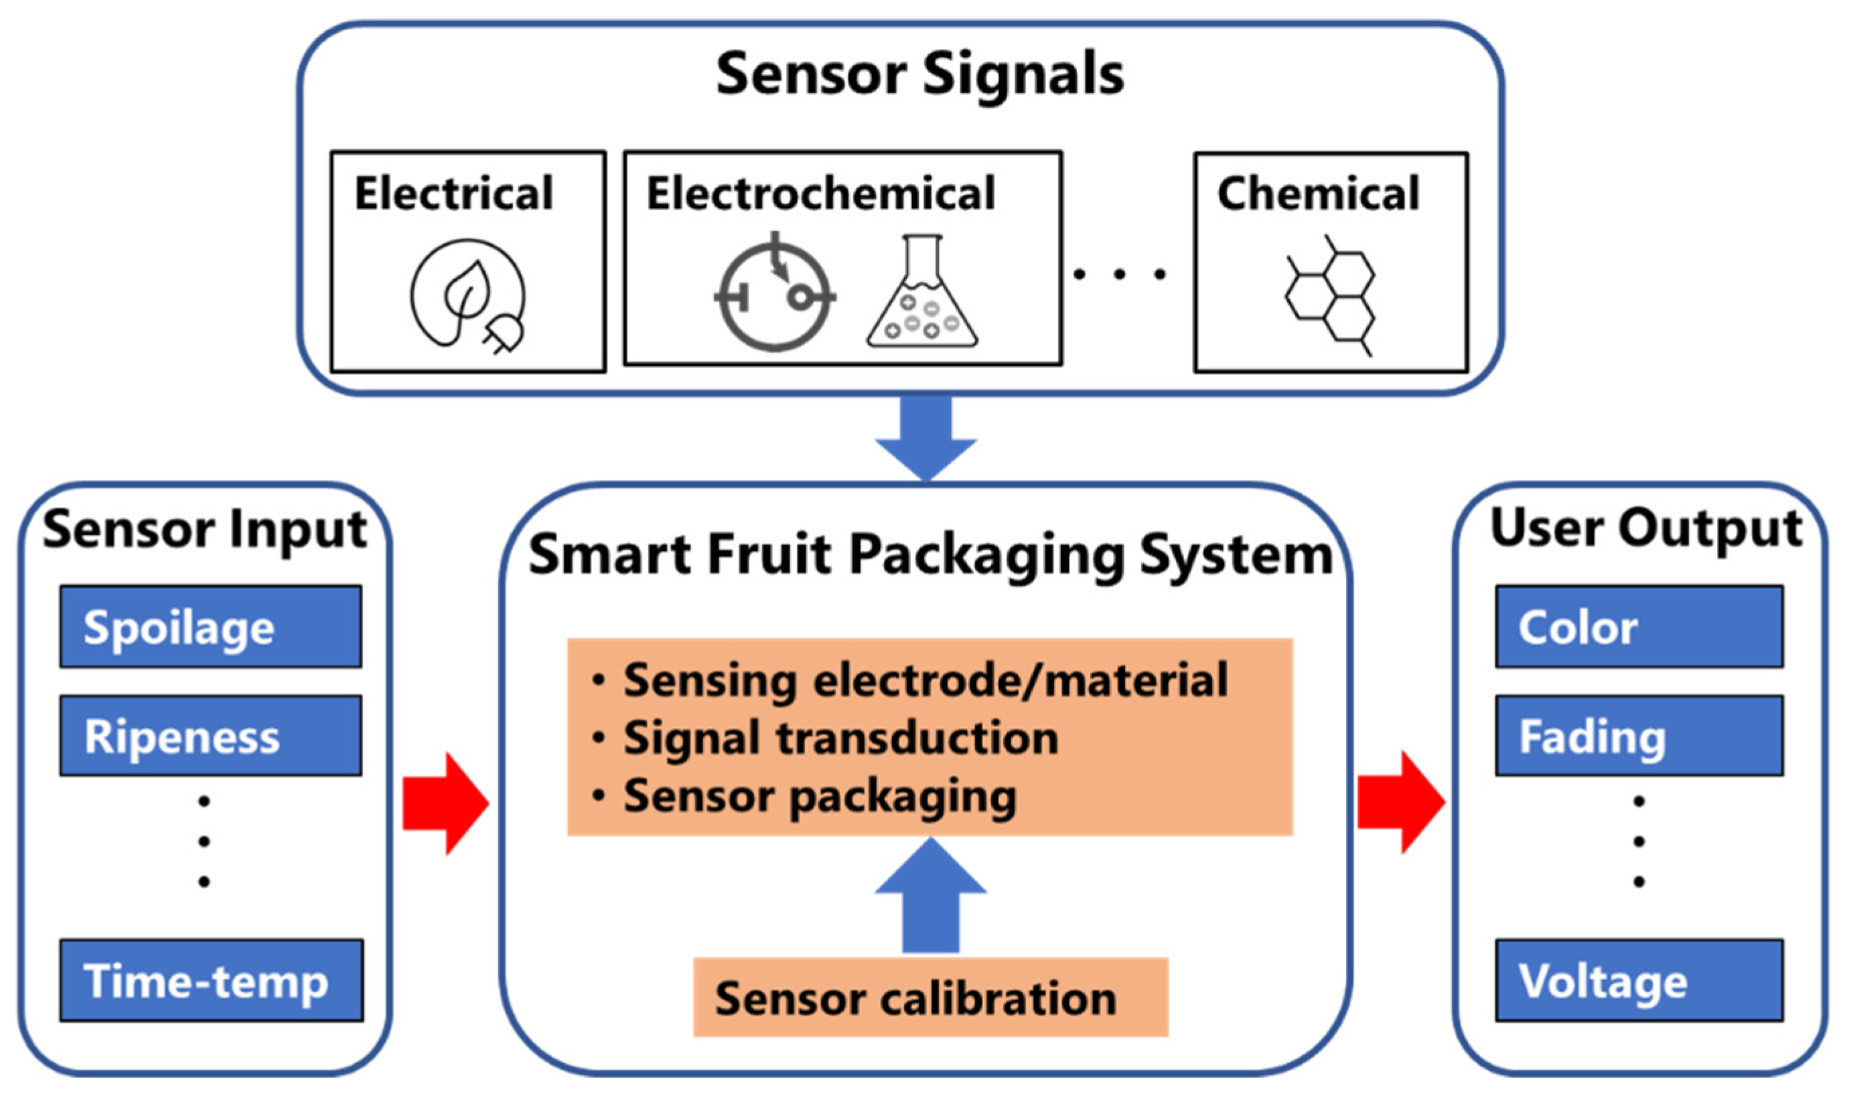
ARCHITECTURE:

Slide 9
BENEFITS:
1. Improved Accuracy: Smart sorting systems can accurately identify rotten fruits and vegetables, reducing errors and improving quality control.
2. Increased Efficiency: Automated sorting processes can significantly reduce the time and labor required for manual inspection.
3. Enhanced Food Safety: Smart sorting systems can help prevent the distribution of spoiled or contaminated food, reducing the risk of foodborne illnesses.
4. Reduced Food Waste: By detecting rotten produce early in the supply chain, smart sorting systems can help reduce food waste and minimize economic losses.
5. Cost Savings: Smart sorting systems can help agricultural and food processing businesses save costs by reducing waste, improving efficiency, and minimizing losses.

Slide 10
CONCLUSION:
Smart sorting with transfer learning offers a highly effective solution for identifying rotten fruits and vegetables. By leveraging pre-trained models and computer vision techniques, this approach enables accurate and efficient detection of spoilage, reducing food waste and improving food safety. The benefits include improved accuracy, increased efficiency, enhanced food safety, and cost savings. As the technology continues to evolve, it holds great promise for transforming the agricultural and food processing industries, ensuring that consumers receive high-quality and safe produce.

Slide 11
THANK YOU

